Slide 1

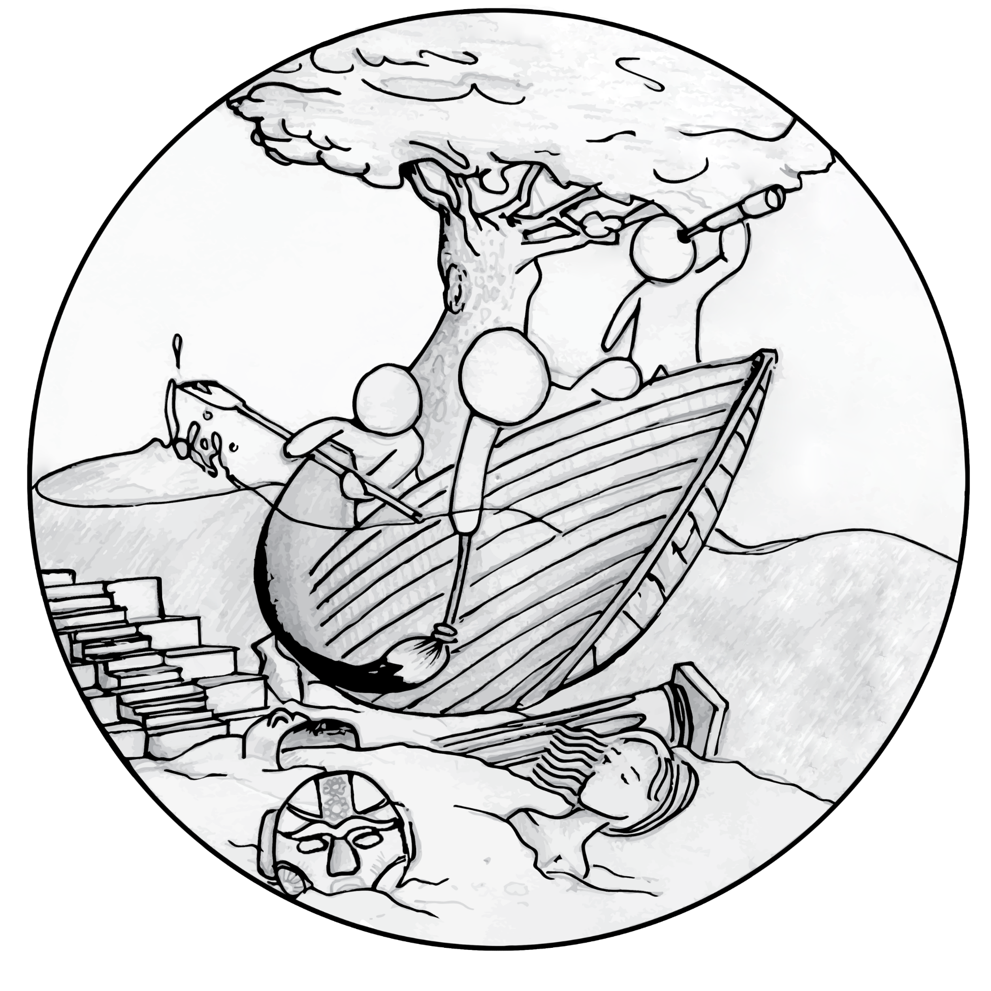

Slide 2
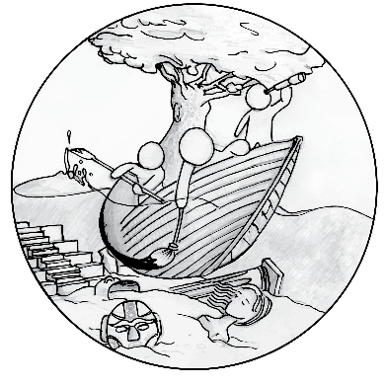
Objective: To create a small, curated space that connects the Olympics to the world of Folk Art; to have a small commercial component where folk art is presented and sold.
“All the world's a stage, and all the men and women merely players: they have their exits and their entrances…”
- William Shakespeare

Slide 3
Artistic Vision: we want people to pass into a different world, one where the World is visible, combining themes of folk art and the Olympics through the conceptual lens of doorways.

Slide 4
Proposed Ideas
Gallery Show
A presentation of “two world stages” at a gallery in Seoul. Folk art and digital promotional materials displayed in gallery with an e-commerce and small commercial area.

Slide 5
Proposed Ideas
Pop Up Market
A creative and attractive “pop-up” kiosk located near traffic going from Seoul to PyeongChang
(i.e. Train Station, Airport) with an e-commerce and small commercial area.

Slide 6
Proposed Ideas
Art Installation
A creative art space that attracts people to “pass into the world stage” with an accompanying
e-commerce and small commercial area.

Slide 7
Proposed Ideas
Fully Realized Folk Art Presence
A combination of all three proposed ideas:
Exhibitions, Pop-Up Markets, and Art Instillations around the city.

Slide 8
Goal
To pass into the shared world of folk art and the Olympics while shaping consumer patterns by
Directing Olympic tourists to experience another parallel world event namely local cultures
In turn raising social awareness while artfully adding to the “global experience”

Slide 9
What We Have
Internationally recognized and respected partners
A socially conscious mission
A message with a strong shared value to protect heritage while supporting entrepreneurship
A vision that is practically and fiscally feasible

Slide 10
How You Can Help
To achieve this goal we wish to build lasting relationships
We are looking for artists, gallery directors, curators, and supporters of the creative economy to help turn this vision into a fully realized world folk art movement.

Slide 11

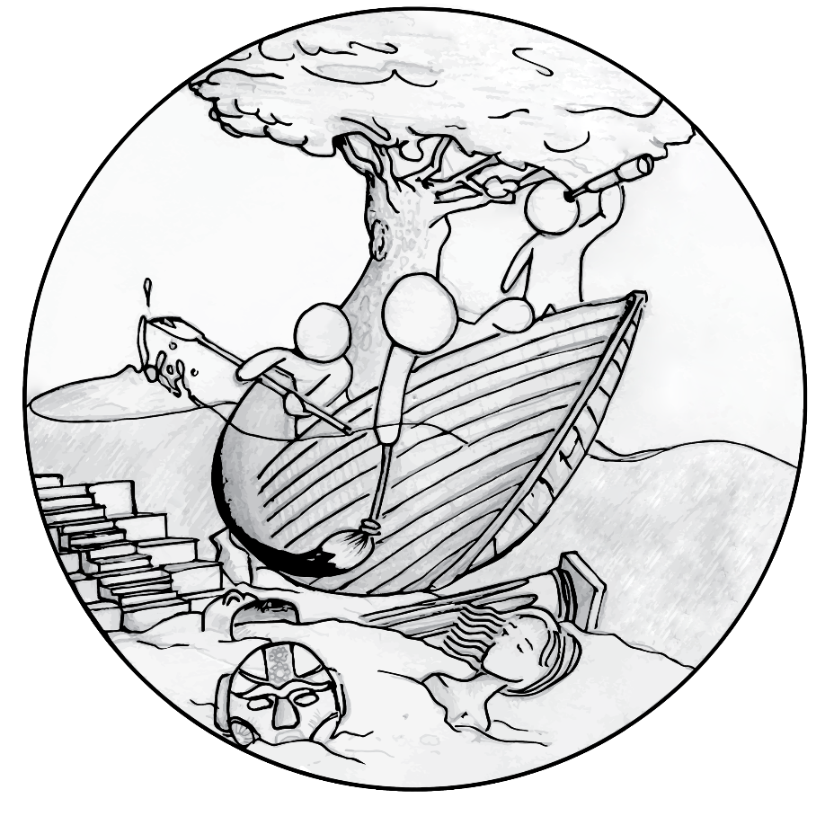
Join the World Folk Art Movement by visiting our site and promoting us on social media
Twitter: @WFAM_IBSG
Instagram: @WFAM_IBSG
Facebook: /worldfolkartmovement
Visit: www.unmibsg.com

